Slide 1
Introduction to jQuery
Lesson 01: JQuery Fundamentals

Slide 2
Lesson Objectives
jQuery Introduction
Why jQuery?
About jQuery.com
Using jQuery
Using Content Delivery Network(CDN)
jQuery Selector
jQuery Effects
jQuery Events
Notes:
Explain the lesson coverage

Slide 3
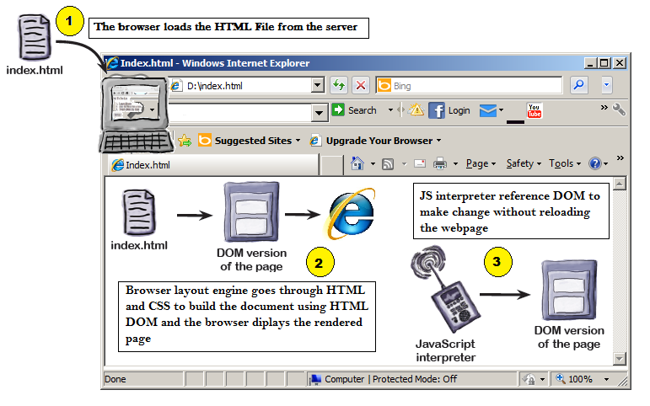
1.1: jQuery Introduction
How webpage works
Notes:
Add the notes here.
Additional notes for instructor

Slide 4

DOM (Document Object Model)

Slide 5
1.1: jQuery Introduction jQuery Introduction
jQuery is a JavaScript library (single file)
jQuery is a lightweight, "write less, do more", JavaScript library
It supports cross browser
Select HTML elements
Handle Events
Animate HTML elements
Make Ajax calls
1000’s of plug-ins available
The purpose of jQuery is to make it much easier to use JavaScript on your website.
Notes:
Additional notes for instructor

Slide 6
1.2: Why jQuery?
Why jQuery?
JavaScript is great for a lot of things especially manipulating the DOM but it’s pretty complex stuff.
jQuery abstracts away a lot of the complexity involved in dealing with the DOM, and makes creating effects super easy.
It can locate elements with a specific class
It can apply styles to multiple elements
It solves the cross browser issues
It supports method chaining
It makes the client side development very easy
Notes:
Add the notes here.
Additional notes for instructor

Slide 7
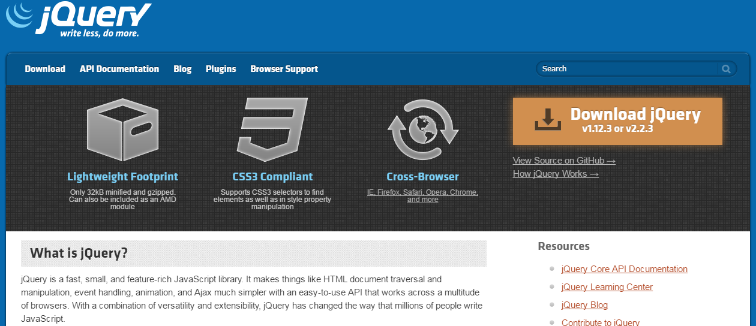
1.3. About jQuery.com jquery.com (Official Website for jQuery)
Notes:
Add the notes here.
Additional notes for instructor

Slide 8
jQuery Syntax
syntax is: $(selector).action()
A $ sign to define/access jQuery
A (selector) to "query (or find)" HTML elements
A jQuery action() to be performed on the element(s)
Example :
$(this).hide() - hides the current element.
$("p").hide() - hides all <p> elements.
$(".test").hide() - hides all elements with class="test".
$("#test").hide() - hides the element with id="test".

Slide 9
Jquery Syntax
$(document).ready(function(){
// jQuery methods go here...
});

Slide 10
1.4. Using jQuery
Using jQuery
  <html>
  <head>
  <title>Test jQuery</title>
  <script type="text/javascript" src="jquery-1.12.3.js"></script>
  <script type="text/javascript">
    $(document).ready(function(){
    alert('Hi'); });
  </script>
  </head>
  <body>
  jQuery Enabled
  </body>
  </html>
Notes:
ready() method is called after the DOM has been initialized
The handler passed to .ready() is guaranteed to be executed after the DOM is ready, so this is usually the best place to attach all other event handlers and run other jQuery code. When using scripts that rely on the value of CSS style properties, it's important to reference external stylesheets or embed style elements before referencing this scripts., the new handler passed in will be executed immediately.
Additional notes for instructor

Slide 11
1.4. Using jQuery
Document.ready
$(document).ready
  Is specific event to jQuery
  Occurs after the HTML document has been loaded
  Is jQuery event that is fired when DOM is loaded, so it’s fired when the document structure is ready.
  Ex -
$(document).ready(function(){ });
Notes:
$(window).load is an event that fires when the DOM and all the content (everything) on the page is fully loaded like CSS, images and frames. One best example is if we want to get the actual image size or to get the details of anything we use it.
$(document).ready() indicates that code in it need to be executed once the DOM got loaded and ready to be manipulated by script. It won't wait for the images to load for executing the jQuery script.
The purpose of the ready event is that it should occur as early as possible after the document has loaded, so that code that adds functionality to the elements in the page doesn't have to wait for all content to load.
Additional notes for instructor

Slide 12
Demo
jQuery
Notes:
noConflict method :
Many JavaScript libraries use $ as a function or variable name, just as jQuery does.
In jQuery’s case, $ is just an alias for jQuery, so all functionality is available without using $. If we need to use another JavaScript library alongside jQuery,
we can return control of $ back to the other library with a call to $.noConflict
Additional notes for instructor

Slide 13
1.5: Content Delivery Network(CDN)
Content Delivery Network(CDN)
Script can be also accessible from
  Microsoft - http://ajax.aspnetcdn.com/ajax/jQuery/jquery-1.12.3.min.js
  jQuery - http://code.jquery.com/jquery-1.12.3.min.js
  Google - http://ajax.googleapis.com/ajax/libs/jquery/1.12.2/jquery.min.js
A CDN short for Content Delivery Network distributes static content across servers. When a user’s browser resolves the URL for these files, their download will automatically target the closest available server in the network.
Notes:
A CDN short for Content Delivery Network distributes static content across servers in various, diverse physical locations. When a user’s browser resolves the URL for these files, their download will automatically target the closest available server in the network.
If jQuery is hosted locally then users must download it at least once. User probably already has dozens of identical copies of jQuery in their browser’s cache, but those copies of jQuery are ignored when they visit your site. Even if someone visits hundreds of sites using the same CDN hosted version of jQuery, they will only need download it once!
Additional notes for instructor

Slide 14
2.1 : Introduction to Selectors
Introduction to selectors
jQuery uses same CSS selectors to style and manipulate elements on the page.
CSS selectors select elements to add style whereas jQuery selectors select elements to add behavior.
Selectors allow page elements to be selected.
Single or Multiple elements are supported.
A Selector identifies an HTML element / tag that will be manipulated with jQuery Code.
Selector Syntax
  $(selectorExpression)
  jQuery(selectorExpression)
Notes:
Additional notes for instructor

Slide 15
2.2. Using Different JQuery Selectors
Tag Selector
Selecting single tag takes the following syntax
  $(‘p’) – selects all <p> elements
  $(‘a’) – selects all <a> elements
To reference multiple tags, use the ( , ) to separate the elements
  $(‘p, a, span’) - selects all paragraphs, anchors and span elements
Notes:
Add the notes here.
Additional notes for instructor

Slide 16
2.2. Using Different JQuery Selectors
Id Selector
It is used to locate the DOM element very fast.
Use the # character to select elements by ID
  $(‘#myID’) – selects <div id=“myid”> element
Notes:
Add the notes here.
Additional notes for instructor

Slide 17
2.2. Using Different JQuery Selectors
Class Selector
Use the ( . ) character to select elements by class name
  $(‘.myclass’) - selects <div class=“myclass”> element
To reference multiple tags, use the ( , ) character to separate the class name.
  $(‘.blueDiv,.redDiv’) - selects all the elements containing the class blueDiv and redDiv
Tag names can be combined with elements name as well.
  $(‘div.myclass’) – selects only <div> tags with class=“myclass”
Notes:
Add the notes here.
Additional notes for instructor

Slide 18
Demo
jQuery Selectors
Notes:
noConflict method :
Many JavaScript libraries use $ as a function or variable name, just as jQuery does.
In jQuery’s case, $ is just an alias for jQuery, so all functionality is available without using $. If we need to use another JavaScript library alongside jQuery,
we can return control of $ back to the other library with a call to $.noConflict
Additional notes for instructor

Slide 19
jQuery Event
All the different visitor's actions that a web page can respond to are called events.
An event represents the precise moment when something happens.
Examples:
  moving a mouse over an element
  selecting a radio button
  clicking on an element
Notes:
Additional notes for instructor

Slide 20
4.2. jQuery Event Model Benefits jQuery Events
Mouse Events | Keyboard Events | Form Events | Document/Window Events
click | keypress | submit | load
dblclick | keydown | change | resize
mouseenter | keyup | focus | scroll
mouseleave |  | blur | unload
Notes:
Additional notes for instructor

Slide 21
Demo
jQuery Events
Notes:
noConflict method :
Many JavaScript libraries use $ as a function or variable name, just as jQuery does.
In jQuery’s case, $ is just an alias for jQuery, so all functionality is available without using $. If we need to use another JavaScript library alongside jQuery,
we can return control of $ back to the other library with a call to $.noConflict
Additional notes for instructor

Slide 22
Summary
jQuery is a cross browser java script library
Available at http://www.jquery.com
The ready() function detects when the DOM hierarchy is loaded
Window.load event fires when the DOM and all the content on the page is fully loaded.
Notes:
Add the notes here.
Additional notes for instructor

Slide 23
Review Question
Which sign does jQuery use as a shortcut for jQuery?
  $ Sign
  % Sign
  # Sign
  ? Sign
Which jQuery function is used to prevent code from running, before the document is finished loading?
  $(document).load()
  $(document).ready()
  $(body).onload()
Notes:
Add the notes here.
Answers
Questions 1: A
Questions 2: B

